Slide 1
Remote and Blended Learning
Zoe.enser@theeducationpeople.org
Andrew.woods@theeducationpeople.org
Claire.Lidyard@theeducationpeople.org
Notes:
Andrew

Slide 2
Aims
To understand the requirements around remote and blended learning.
To understand some of the issues around remote and blended learning (practical issues, safeguarding, SEN).
To consider importance of curriculum and pedagogy in relation to remote learning.

Slide 3
Government Requirements
Where a class, group or a small number of pupils need to self-isolate, or local restrictions require pupils to remain at home, we expect schools to have the capacity to offer immediate remote education.
(As of 22 October)
https://www.gov.uk/guidance/remote-education-during-coronavirus-covid-19
Notes:
Zoe- I am aware there is some discussion about possible changes to the guidance around who has to isolate, but even if one student is isolating the requirement is for them to have access to remote education

Slide 4
Schools are also expected to. . .
use a curriculum sequence that allows access to high-quality online and offline resources and teaching videos and that is linked to the school’s curriculum expectations
give access to high quality remote education resources
select the online tools that will be consistently used across the school in order to allow interaction, assessment and feedback and make sure staff are trained in their use
provide printed resources, such as textbooks and workbooks, for pupils who do not have suitable online access.
Notes:
Zoe-= the point about linking to curriculum expectations is really key here. The report from the initial Ofsted findings last week, indicated the most effective remote learning aligned as far as possible to the school’s curriculum. Where this wasn’t happening it was more difficult for students to engage and continue to make progress using the curriculum model. (file:///C:/Users/EnserZ01/AppData/Local/Microsoft/Windows/INetCache/Content.Outlook/59X7FEK7/Schools_briefing_COVID-19_series_Sept-2020.pdf)
High quality – as the moment we don’t have a clear definition of exactly what that looks like, although the EEF’s rapid review of remote learning did attempt to answer some of these questions and we have used that to inform some of the next steps we will explore. And the final two points are really about making sure that whatever approach you take to blended or remote learning, students have equality of access and staff are proficient in use and know their uses and limitations

Slide 5
Schools should also…
recognise that younger pupils and some pupils with SEND may not be able to access remote education without adult support and so schools should work with families to deliver a broad and ambitious curriculum.
Notes:
Claire

Slide 6
Aims
To understand the requirements around remote and blended learning.
To understand some of the issues around remote and blended learning (practical issues, safeguarding, SEN).
To consider importance of curriculum and pedagogy in relation to remote learning.

Slide 7
SEN-Safeguarding
Consider | For example | Actions to support
Vulnerability from need The impact that the young person's needs have on vulnerability. Can the needs be met at home? What support is needed to facilitate learning at home? | A young person with ADHD at home can be challenging for care givers. Additional environmental factors can ascorbate characteristics of the need. | Risk assessments- assess the risk of learning in all environments Ensure that work is differentiated and accessible. Ensure that instructions are clear for parents as well as young person. Maintain regular contact to support and continually assess risk as well as to provide support.
Vulnerability from workload What is impact of the expected learning on the young person and home environment? | There may not be the capacity or the specialism to provide a high level of support at home. Does the expected workload create challenges and does this increase a young persons vulnerability?

Slide 8
SEN- Accessibility
Consider | For example | Actions to support
Vulnerability from need The impact that the young person's needs have on accessibility. Are teachers aware of the needs? What support is needed to facilitate learning at home? | A young person with literacy difficulties may rely on 1:1 HLTA is school at home there are other siblings and one laptop. How can this young person access and complete his work? | Ensure that work is differentiated and accessible. Interventions as online classes Ensure that instructions are clear for parents as well as young person. Utilise resources to support planning e.g Oak Academy, SAM Learning Focus on accessibility as part of departmental planning for blended learning Maintain regular contact to support and continually assess risk as well as to provide support.
Resources and support: What is available to the young person when completing work that has been set? | There may not be the capacity or the specialism to provide a high level of support at home.

Slide 9
Practical Considerations
Systems already available- what worked well? What can be developed further?
Checking access and training for students
Training for staff and students on systems
Workload.
Notes:
Claire
KELSI link to access
Delegation (its everybodies job)

Slide 10
Safeguarding
Revisit the safeguarding protocols established during lockdown and refresh for all staff (more information can be found here and here
Consider the possible issues with different approaches (live teaching for example requires the appropriate environment and supervision at both sides of the screen, protocols need to be in place to anticipate issues or to address an issue should it arise).
Seek support and advice from outside agencies as appropriate.
More support can be found via The Education People’s Safeguarding team

Slide 11
Aims
To understand the requirements around remote and blended learning.
To understand some of the issues around remote and blended learning (practical issues, safeguarding, SEN).
To consider importance of curriculum and pedagogy in relation to remote learning.

Slide 12
Reflection
Which approaches to remote or blended learning have you already used over the last 6 months?
Self marked questions on google forms or similar
Live interactive lessons
Your own pre-recorded lessons on PPT or similar
Reading materials/ booklets
Recorded lessons from people like Oak National
Dojo
Tasks/ materials set on show my homework/ firefly etc
Email exchanges
Other.
Notes:
Zoe - so we have talked a lot about what the expectations are, but these are of course practices you have been using for months over lockdown and since full opening. Context is always important so we wanted to take some time to allow you to reflect on what you have used and what maybe you can learn from others’ experiences. Let’s begin with a poll

Slide 13
Further Points to Consider
What, in your experience, has been the most effective approach to remote learning in your context?
What have been some of the barriers/ limitations?
How have you been able to overcome these?
Notes:
Zoe – now let’s unpick that a bit more (possible break out room?)
Feedback and key takeaways

Slide 14
Curriculum
Continuing to teach all or most of the normal planned curriculum in the remote environment is important
https://www.gov.uk/government/publications/remote-education-good-practice/remote-education-good-practice,
Notes:
Zoe- as mentioned earlier, this is considered essential in minimizing lost learning as far as possible and that pupils can continue to progress through the curriculum, something which is regarding as key in the 2019 EIF. This means ensuring, as far as possible, the broad range of subjects other students will be experiencing and that the curriculum isn’t narrowed for those who can’t attend. This can be tricky where some subjects may translate more quickly to remote practices than others, but again with careful planning this should be possible, even if you find you might have to take different approaches in different areas sometimes.
The sequence of this curriculum will continue to be an important consideration as it is through this that we can see pupil progress.

Slide 15
Curriculum
1. What are the absolute necessities in the curriculum (threshold concepts etc)?
2. Is it best delivered in the classroom or at home? Which parts?
3. How will you assess this?
4. What opportunities will there be for deliberate practice?
5. What are the consideration for a practical subject?
Notes:
Focus on key areas- strip back
Think about what elements will/ won’t work in the home environment. Where will students potentially be at greater risk of embedding misconceptions? Where is greater guidance needed and how can we support this?
Then we need to think about our assessment- we can only really assess when we are really clear on what is being assessed and why- so again back to thinking about the curriculum.
What opportunities are there for deliberate and spaced practice. If we are talking deliberate practice that should be about embedding learning so will need quick feedback to ensure that this is what is actually happening. Again is this at home or in school or what mechanisms, such as models can be in place for that
Will need to define deliberate practice? (purposeful, systematic and focused on improving performance. Requires immediate and precise actionable feedback)

Slide 16
Effective Pedagogy
The Education Endowment Foundation (EEF) has found that the effectiveness of remote teaching is determined by many of the same factors as determine the effectiveness of live classroom teaching. For example:
ensuring pupils receive clear explanations
supporting growth in confidence with new material through scaffolded practice
application of new knowledge or skills
enabling pupils to receive feedback on how to progress.

Slide 17
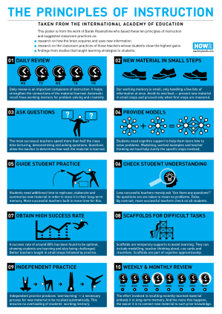
Effective Instruction
Recap
2. Introduce material in small steps
3. Model and give examples
4. Check understanding (remotely?)
5. Give time to guided practice/ scaffold
6. Give time for independent practise.

Slide 18
 | Pros | Cons
Live lessons | Real time teacher and learner interaction Immediate responses Social interactions Allows responsive teaching FAQ can be addressed for the benefit of the whole class | Workload Relies on various quality of internet connections Teaching and learning constraints Scheduling of time Not always possible to give individual feedback due to time
On demand lessons | Many subject organisations have premade lessons Not constrained by scheduling time slots Potentially more accessible for SEND students Students learn at their own rate of learning and enables pause or revisit material | Some subscriptions are expensive Outsourced lessons are less personal Delay in instruction and interaction with teacher for feedback Reduces the effects of responsive teaching Common misconceptions and misunderstanding more unlikely to go without being addressed

Slide 19
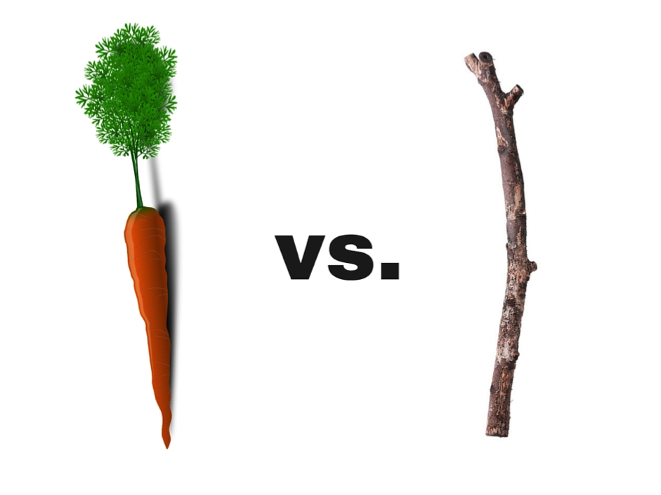
Learner Motivation
student reactions to remote learning
whole school clarity
recognition of completed work
motivation fades very quickly if a students doesn't succeed
share the learning journey

Slide 20
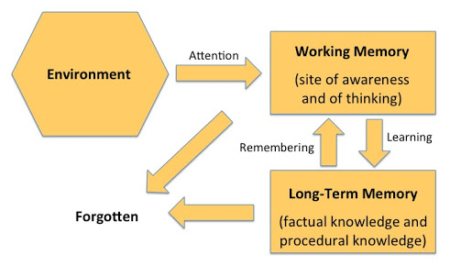
Considering Your Approach
Notes:
Claire? 10 What information is being presented? What pause points are you using? What opportunities are you giving students to assimilate information into their schema by doing something with it
How are students recording/journaling their learning?

Slide 21
Inclusion
Pupils in the early stages of their formal education are likely to have particular needs which cannot easily be addressed in the same way as those of other pupils. Likewise, some pupils with SEND will require specific approaches tailored to their circumstances. https://www.gov.uk/government/publications/remote-education-good-practice/remote-education-good-practice
Schools need to adhere to the 2010 Equality Act with special emphasis on section 5, protected characteristics.
They also need to adhere to the broader elements of the act where reasonable adjustments are required to be made to ensure equality of access. This could be applied to access of technology, access to support, differentiation and equality with the in-school offer. Pupils with EAL, those with SEND, those living in overcrowded accommodation, young carers and those deemed as disadvantaged will need to be considered in the reasonable adjustments.

Slide 22
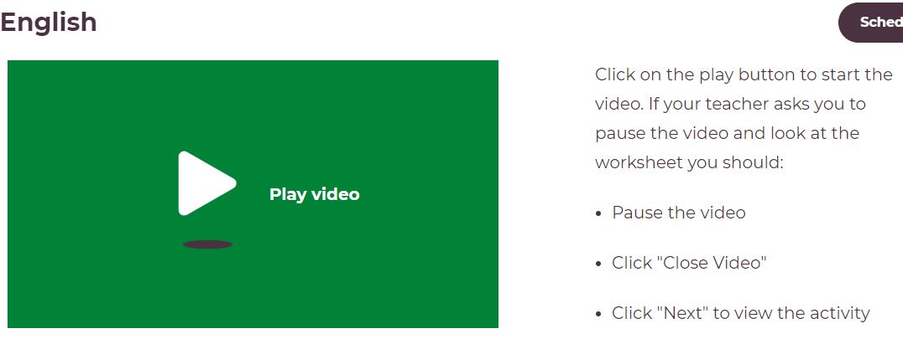
Approaches

Slide 23
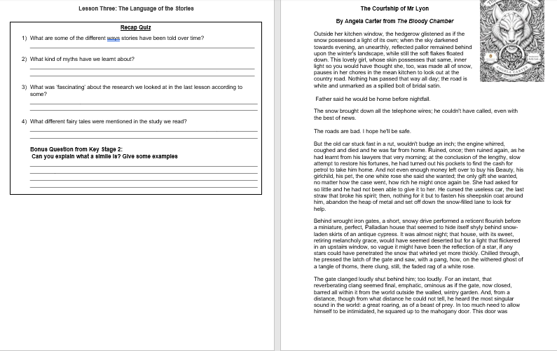
Approaches

Slide 24
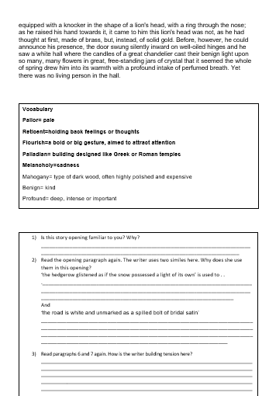
Approaches
https://www.tes.com/news/coronavirus-blended-learning-booklets

Slide 25
Key Pedalogical Points
steps and stages (video or otherwise)
clarity of explanation, including expectations
use of visuals to enhance
recap/ review.

Slide 26
Next Steps
What are the main points you want to take back to your teams?
What further information do you need?
How could you work with other schools here today to share materials or resources?
4. How could The Education People support you further with
Remote Learning in your context?

Slide 27
Aims
To understand the requirements around remote and blended learning.
To understand some of the issues around remote and blended learning (practical issues, safeguarding, SEN).
To consider importance of curriculum and pedagogy in relation to remote learning.

Slide 28
References/ Further Guidance
https://www.gov.uk/government/publications/actions-for-schools-during-the-coronavirus-outbreak/guidance-for-full-opening-schools#res
https://www.kelsi.org.uk/__data/assets/pdf_file/0018/110907/September-Secondary-Guidance.pdf
https://www.gov.uk/government/publications/remote-education-good-practice/remote-education-good-practice
https://www.tes.com/news/coronavirus-blended-learning-booklets
https://educationendowmentfoundation.org.uk/covid-19-resources/best-evidence-on-supporting-students-to-learn-remotely/
https://www.gov.uk/guidance/remote-education-during-coronavirus-covid-19

Slide 29
Further Advice
Siobhan.price@theeducationpeople.org
Kim.gunn@theeducationpeople.org
Zoe.enser@theeducationpeople.org
Andrew.woods@theeducationpeople.org
Claire.Lidyard@theeducationpeople.org

