Slide 1
Kent County Council Schools Bankline Presentation
Presented by Gill Pegrum
June 2018

Slide 2
Contents
Welcome to Bankline/Logging On
Bankline Account Information
Importing Payments
Frequently Asked Questions
Staying Safe Online

Slide 3
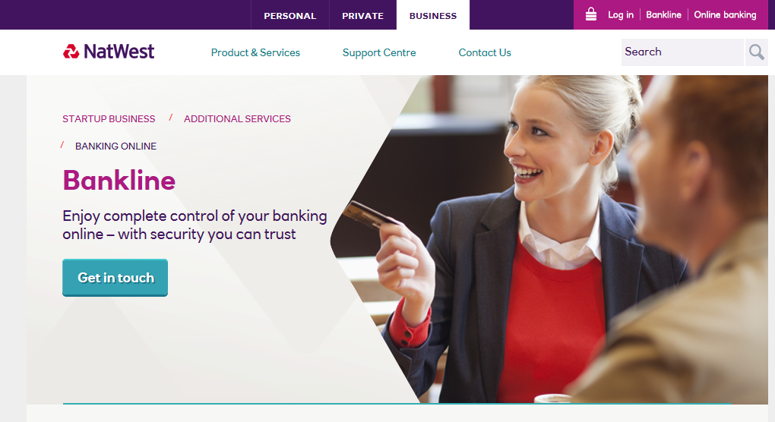
Bankline Welcome Screen

Slide 4
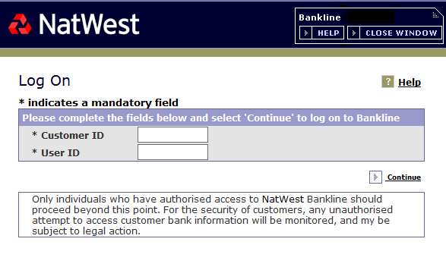
Logging On to Bankline

Slide 5
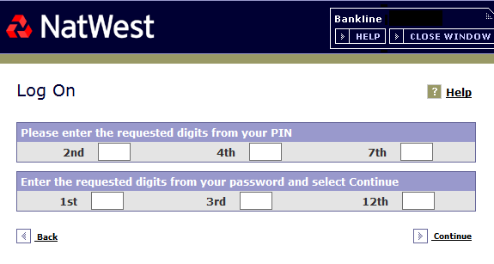
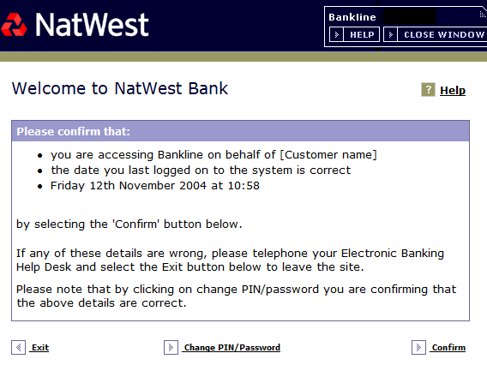
Logging On to Bankline

Slide 6
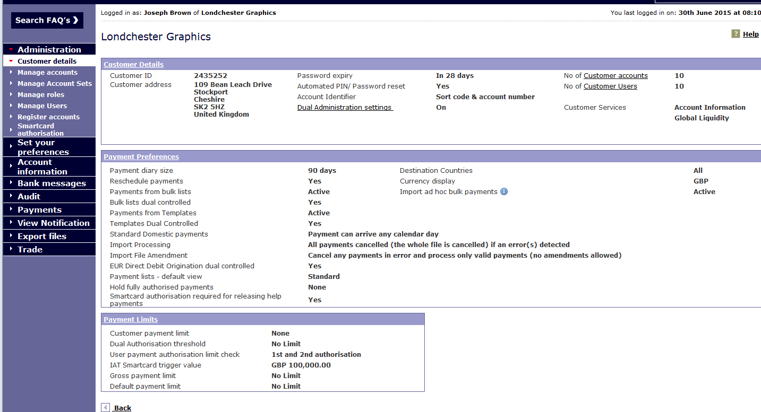
Customer Details for Bankline Profile

Slide 7
Account Information

Slide 8
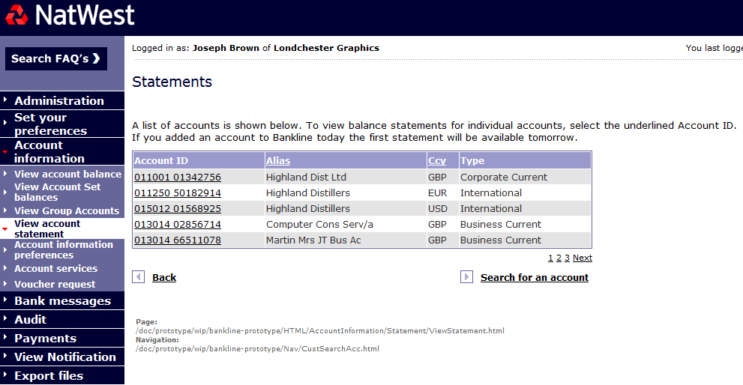
View Account Statements

Slide 9
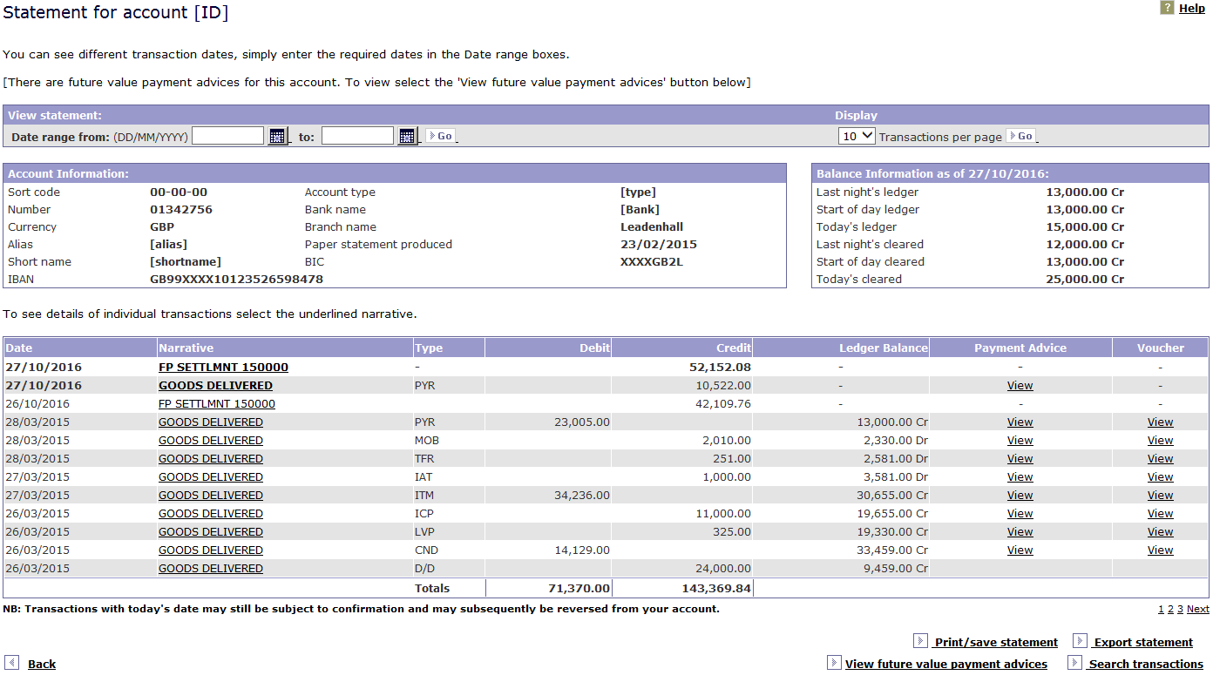
Statement Information

Slide 10
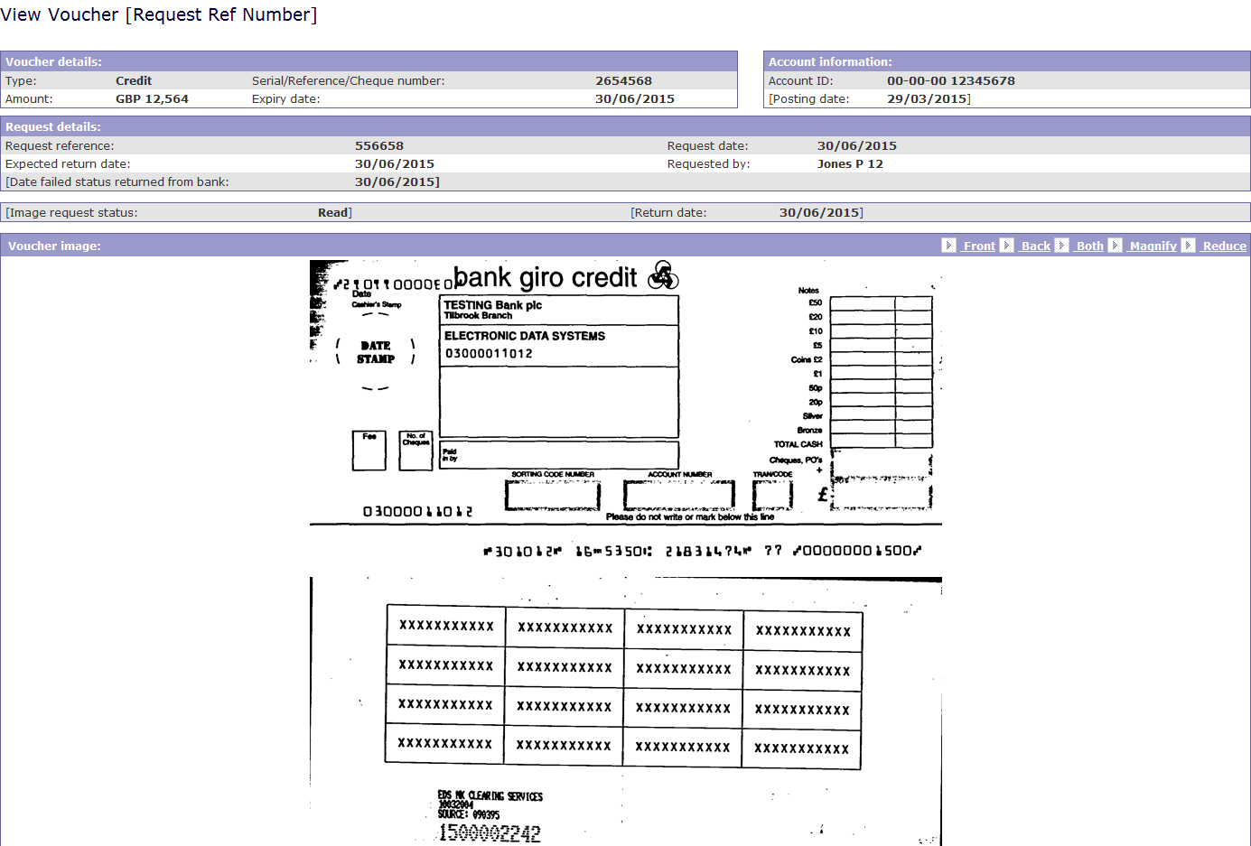
Voucher Request

Slide 11
Importing Payments

Slide 12
Importing Payments cont..

Slide 13
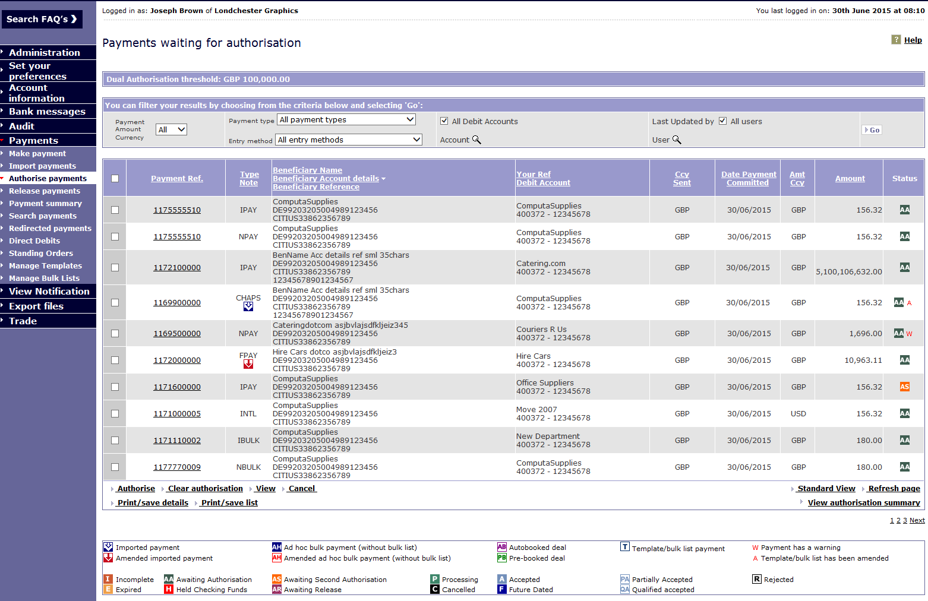
Payment Authorisation

Slide 14
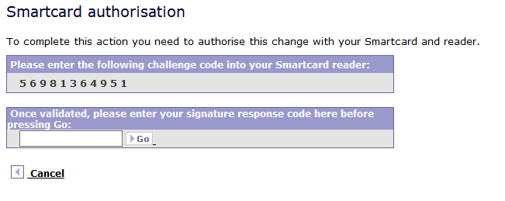
Smartcard Authorisation

Slide 15
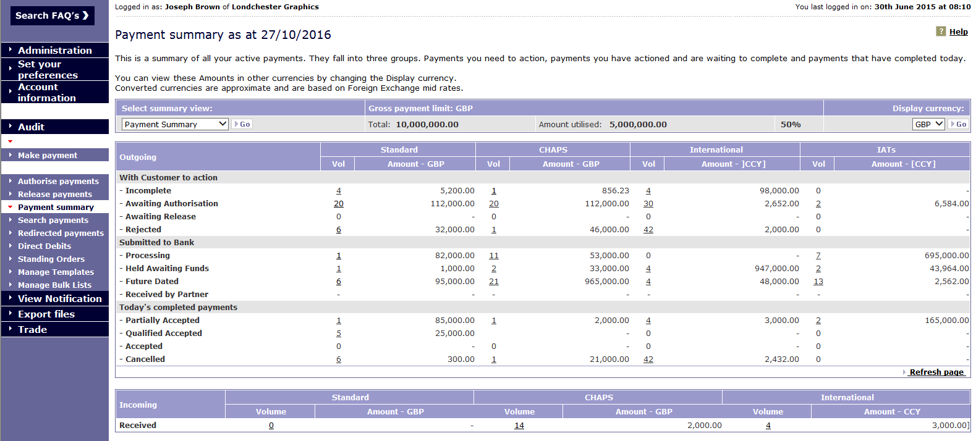
Payment Summary

Slide 16
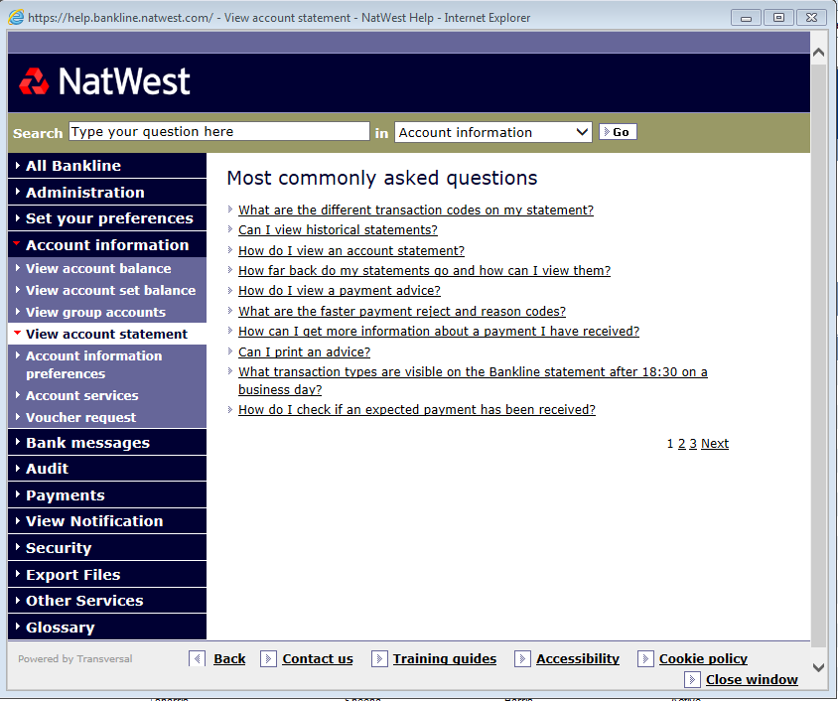
Frequently Asked Questions

Slide 17
Bankline Golden Rules
We will never...
Ask for your full PIN & password online: only 3 random digits from each are needed to log in
Ask for your PIN & password or any smartcard codes over the telephone: beware of imposters
Ask for smartcard codes to log in: these codes are used to authorise payments
Ask you to make test payments to prevent fraud

Slide 18
Top Tops for Staying Safe Online
Keep software up to date
Strong controls – dual administration / dual authorisation.
Segregation of duties
Bankline Broadcast Messages & Fraud Awareness Material
User Awareness.
Use the functionality of Smartcard authorisation and dual authorisation to protect your payments and changes made in Bankline
Check user privileges and that users don’t have access to information and functionality that they don’t need
Create a secure password that cannot be guessed
Download Trusteer Rapport security software to protect your computer.

Slide 19
Contact details
Bankline Helpdesk 0345 300 4108
Bankline Webchat – click the icon when logged on
Corporate Service Team –
Tel: 0345 308 8964
email - Commercial.Emails.CS&OBolton@rbs.co.uk

Slide 20
Any Questions

