Slide 1
Finance Information Group
Schools Financial Services
Financial Risk Register
June 2020
www.theeducationpeople.org

Slide 2
Financial Risk Register
KCC Audit have highlighted that not all schools are aware of and are not recording the financial risks that could affect them. They should be doing the following actions.
Identifying the risks and how these link to the School Improvement Plan.
Identifying the level of impact to the school.
Have early warning indicators in place.
Know who is responsible for managing the risk and who is providing updates.
What actions will be undertaken to reduce the risks impact.
www.theeducationpeople.org
Notes:
.

Slide 3
Financial Risk Register
To assist schools a Financial Risk Register, as an excel template, is available on Kelsi for use by all Kent maintained schools.
Kelsi.org.uk/school-finance/financial-support-and-planning/schools-financial-risk-register
Completing a risk register helps schools identify these risks.
It puts plans in place to reduce or eliminate any adverse effect either financial or reputational on the school.
Not all financial risks will have a clear link to the School Improvement Plan, however, these should also be included.
This should be completed on an annual basis as part of the budget setting process. It should be approved and reviewed , at least annually, by the governing body.
www.theeducationpeople.org

Slide 4
Financial Risk Register
The Financial Risk Register is available to use to record and monitor financial (and other) risks that may impact schools.
Four sections:
Risk Identification (red section)
Risk Analysis (yellow section)
Risk Evaluation (blue section)
Risk Treatment (green section)
It does not need to be submitted to the Local Authority but must be available during any compliance visits.
www.theeducationpeople.org

Slide 5
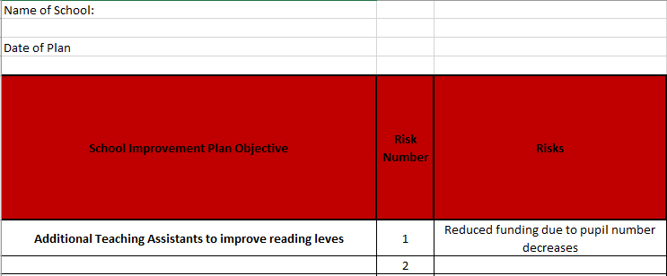
Financial Risk Register
Risk identification
All risks should link to the School Improvement Plan objectives and be assigned a specific number.
www.theeducationpeople.org

Slide 6
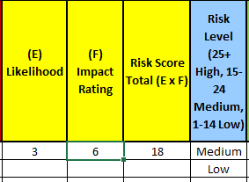
Financial Risk Register
Risk Analysis and Evaluation
Add a score (1 to 6) for both likelihood and impact 1 (Risk Analysis). Risk register will then generate a level (Risk Evaluation) based on the score calculated.
www.theeducationpeople.org

Slide 7
Financial Risk Register
Risk Treatment
Add details of who is responsible for monitoring the risk, what early indicators of the risk coming to pass will be and what plans will be put into action to reduce the impact to the school.
www.theeducationpeople.org

Slide 8
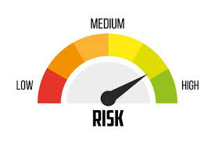
Thank you
www.theeducationpeople.org

